Slide 1

Design and Implementation of Online Shopping System
By
Nivas Kanmanthareddy
Sri Gayatri Mudimbi
Keerthana Sankaramaddi
Asha Jyothi Mannem

Slide 2
Introduction
In today’s fast-changing business environment, it’s extremely important to be able to respond to client needs in the most effective and timely manner.
E-commerce is rapidly gaining traction as an accepted and used business model. More and more traders are setting up websites that provide the functionality of conducting business transactions over the web.
The goal of this project is to develop a general-purpose e-commerce store where products such as clothing and electronics can be purchased from the comfort of home via the internet.
To develop an e-commerce website, several Technologies must be studied and understood.

Slide 3
Overview
Any member can register and view available products.
Only registered member can purchase multiple products regardless of quantity.
Contact Us page is available to contact Admin for queries.
There are three roles available: Visitor, User and Admin.
Visitor can view available products.
User can view and purchase products.
An Admin has some extra privilege including all privilege of visitor and user.
Admin can add products, edit product information and add/remove product.
Admin can add user, edit user information, and can remove user.
Admin can ship order to user based on order placed by sending confirmation mail.

Slide 4
Web Pages details:
Home Page
Electronics Page
Contact Us Page
Admin Page
Login Page
Register Page

Slide 5
TECHNICAL TOOLS:
The various system tools that have been used in developing both the front end and the back end of the project are:
FRONT END:
JSP
HTML
CSS
JAVA SCRIPT
BACK END: The back end is implemented using MySQL which is used to design the databases.

Slide 6
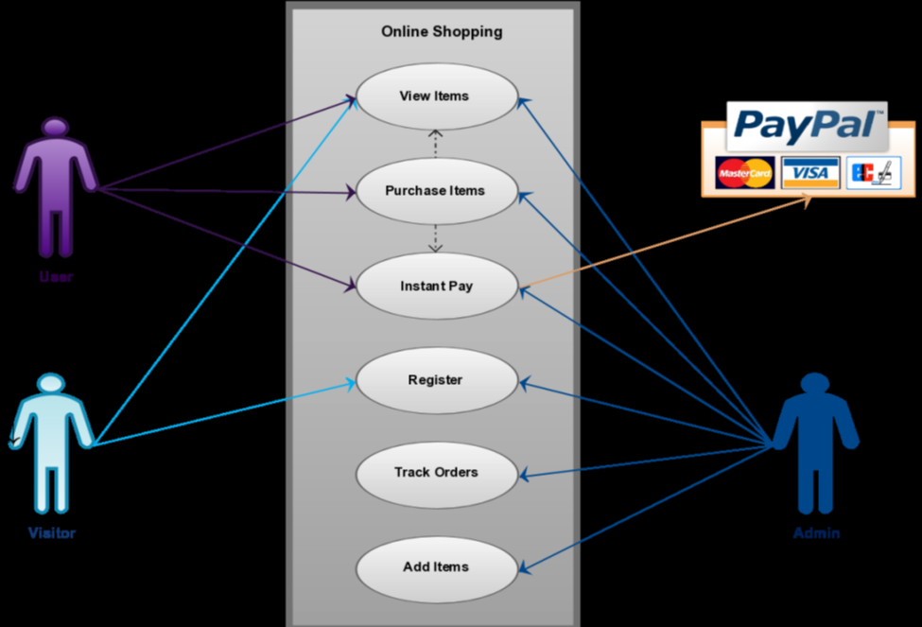
SYSTEM REQUREMENTS:
USE-CASE DIAGRAM:

Slide 7
ONLINE SHOPPING PORTAL:
Anyone can view Online Shopping portal and available products, but every user must login by his/her Username and password to purchase or order products.
Unregistered members can register by navigating to registration page. Only Admin will have access to modify roles, by default developer can only be an ‘Admin’.
Once user register site, his default role will be ‘User’.

Slide 8
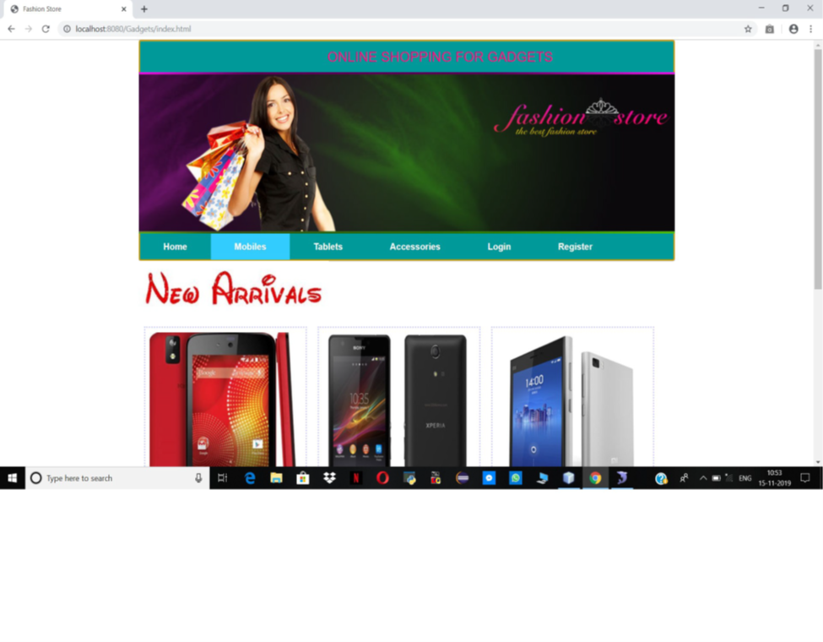
Home Page
The Home page will consist of screen were one can browse through the products which we have on our website.

Slide 9
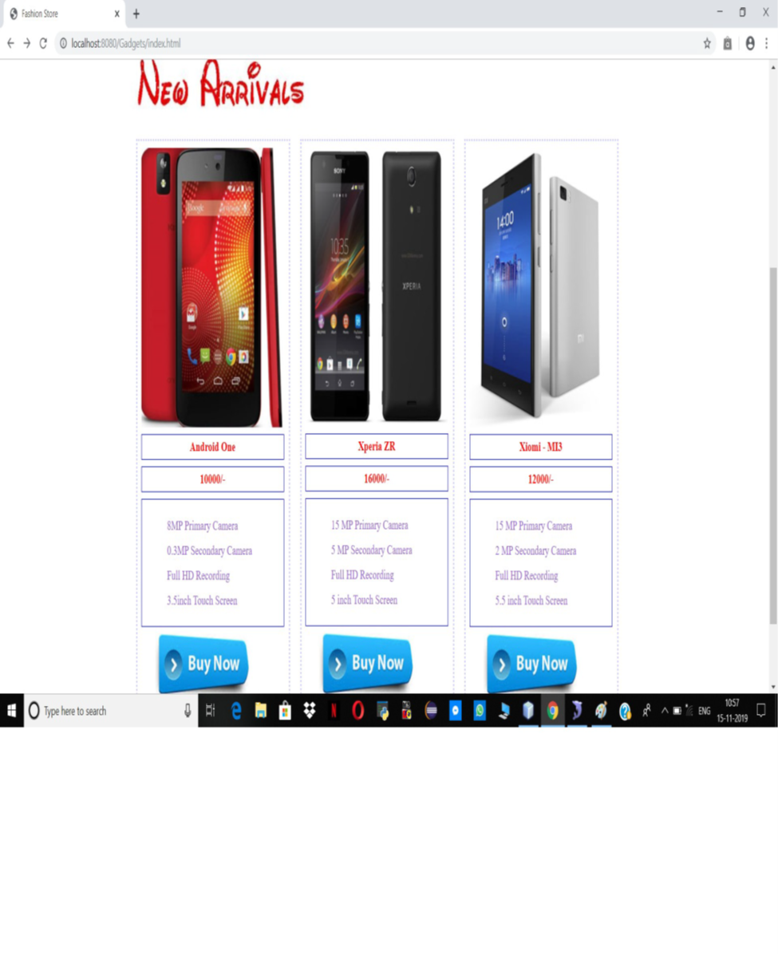
ELECTRONICS PAGE (PRODUCTS)
This page consists of product details. This page appears same for both visitors and users

Slide 10
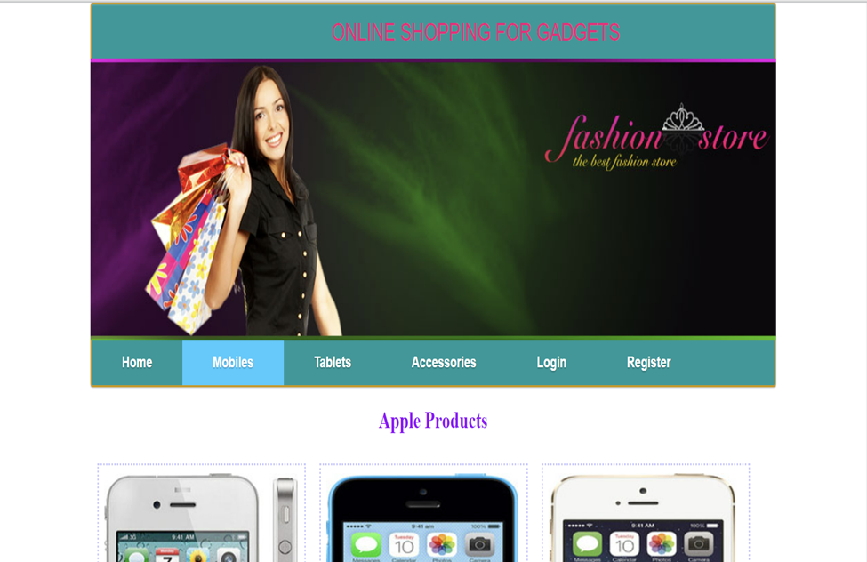
ORDER US PAGE:
Registered users can order desired products from here.

Slide 11
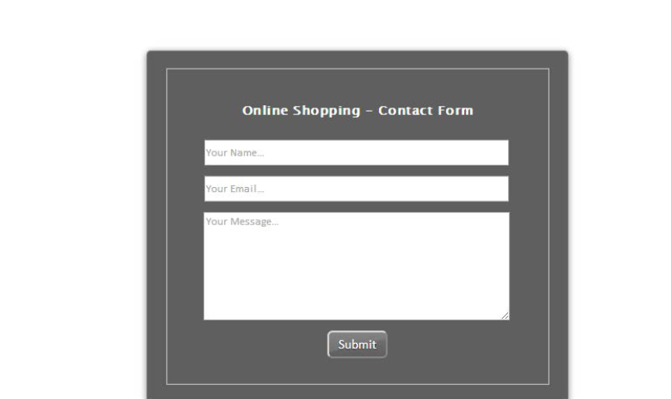
Contact Us Page:
Visitors and Registered users can contact website owners or administrators from here.

Slide 12
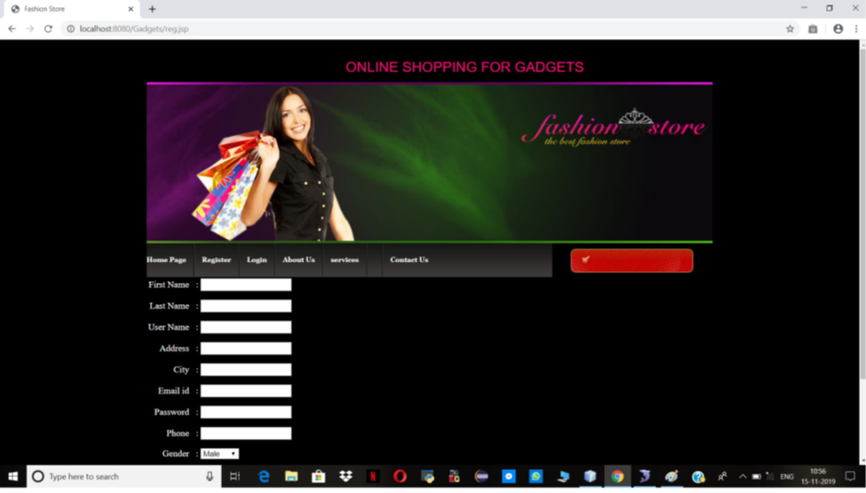
REGISTER PAGE:
New users can register here

Slide 13
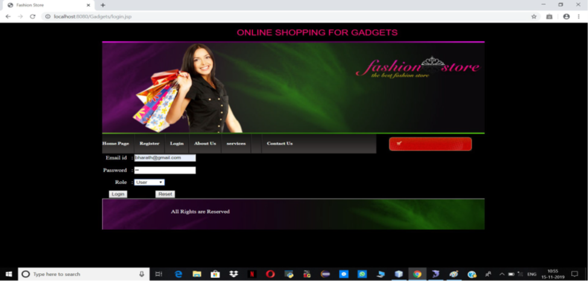
LOGIN PAGE:
Login page for both users and administrators.

Slide 14
Admin Page:
Only difference you see in this page is Role: Admin. User and Admin role will be checked once the page was login and Session [“role”] will be either Admin or User. If credentials belong to Admin, then role will be Admin and if credentials belong to User, then role will be User.

Slide 15
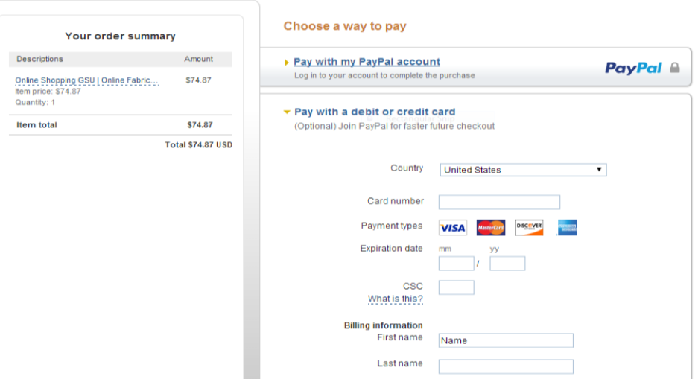
PAYPAL FOR PAYMENT:
Once users order products, they are redirected to a payment page.

Slide 16
Data Management:
Data Description :
This database consists of
Users: User and Admin information is added to database with Unique ID based on their roles.
Shopping: Complete products information is stored in this table.
Orders: Customer ordered products, status and delivery information is stored in this table.

Slide 17
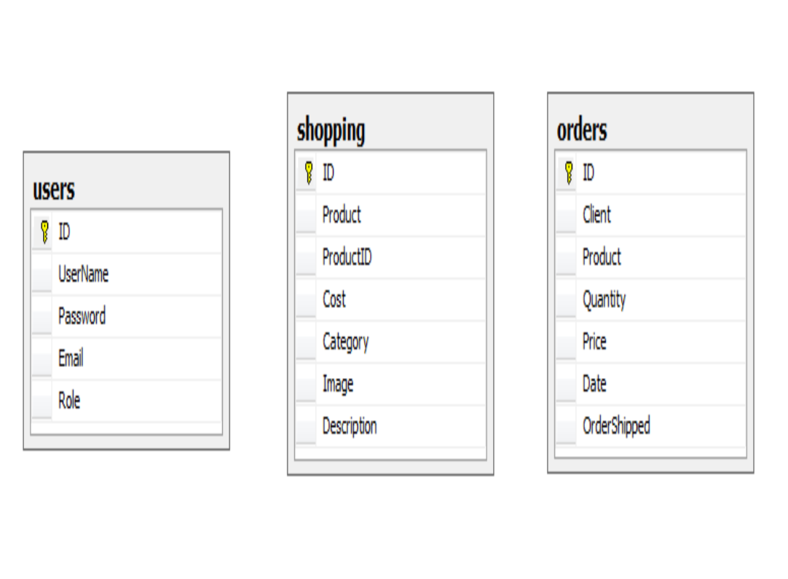
Data Objects:
User: ID, Username, Password, Email, Role
Shopping: ID, Product, Product ID, Cost, Category, Image, Description
Orders: ID, Client, Product, Quantity, Price, Date, Order Shipped
Database Table Diagram:

Slide 18
Non-Functional / Operational Requirements:
Security :
Pages of the website must be access in the way they were intended to be accessed. Included files shall not be accessed outside of their parent file.
Administrator can only perform administrative task on pages they are privileged to access. Customers will not be allowed to access the administrator pages.

Slide 19
Efficiency and Maintainability:
Page loads should be returned and formatted in a timely fashion depending on the request being made.
Administrators will have the ability to edit the aspects of the order forms, product descriptions, prices, and website directly.

Slide 20
E-Commerce Testing Checklist:
Below, we have listed important segments and test cases for eCommerce website testing.
1. Homepage
2. Search
3. Product Details
4. Shopping Cart
5. Payments
6. After-Order Tests
7. Other Tests

Slide 21
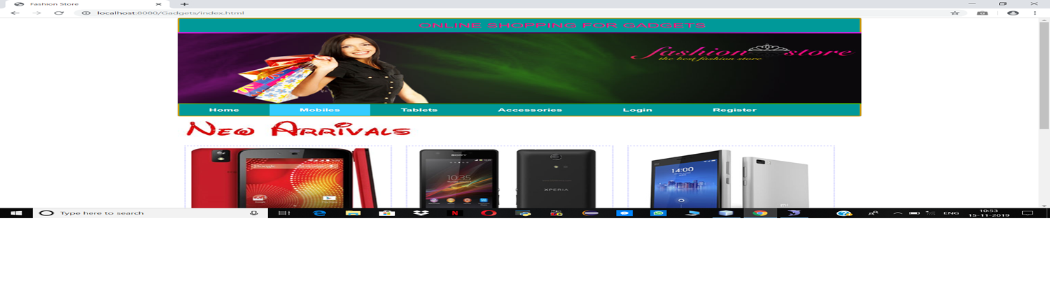
Homepage:
Homepages of retail sites are busy. They have a lot going on.
This is the kind of the clickable image (a slideshow of sorts) that occupies the majority of the page.

Slide 22
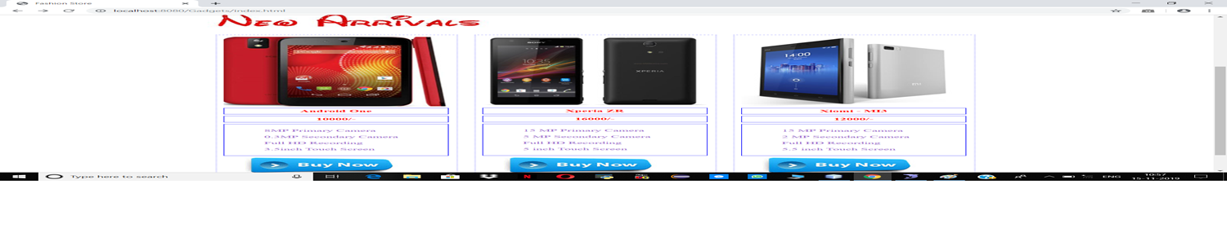
Product Details Page:
Once a user finds a product either through search or by browsing or by clicking on it from the homepage, the user will be taken to the product information page.

Slide 23
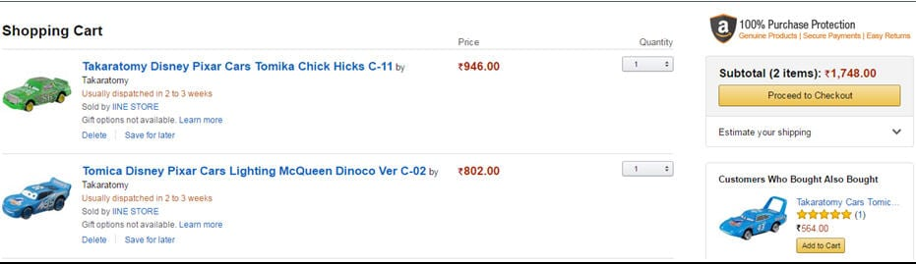
Shopping Cart:
This is the penultimate stage before the user commits to the purchase.

Slide 24
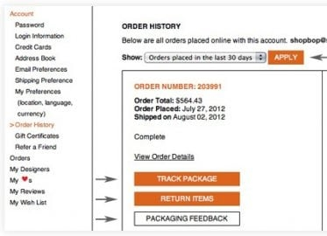
After-Order Tests
Check:
Change the Order
Cancel the Order
Track the Order
Returns

Slide 25
Other Tests
Login
FAQs
Contact Us page
Customer Service page etc.

Slide 26
Conclusion
As per a survey, most consumers of online stores are impulsive and usually decide to stay on a site within the first few seconds. “Website design is like a shop interior. If the shop looks poor or like hundreds of other shops the customer is most likely to skip to the other site. Hence, we have designed the project to provide the user with easy navigation, retrieval of data and necessary feedback as much as possible. In this project, the user is provided with an ecommerce web site that can be used to buy electronics online.

Slide 27
Thank You

